Slide 1
Enterprise e-learning platform
Tushar Bhardwaj
12216999
1

Slide 2
cONTENTS
1
2
introduction
Project TIMELINE
3
4
description
Technologies USED
5
6
Step by step process
Interface
7
8
Node modules
conclusion
2

Slide 3
introduction
In an era where digital education has become an integral part of the learning landscape, our platform aims to provide a holistic and interactive environment for individuals seeking knowledge and those looking to share their expertise.
The platform will feature a range of functionalities, ensuring a smooth user experience and fostering an engaging and collaborative learning community. This platform is designed to cater to the needs of both learners and instructors, offering a seamless and enriching educational experience.
The primary goal of this project is to create a robust and feature-rich e-learning solution that addresses the distinct requirements of students, instructors, and administrators alike. By leveraging the capabilities of the MERN stack and adopting a comprehensive approach to platform development, we aim to deliver a robust, intuitive, and scalable solution capable of meeting the diverse learning needs of modern enterprises.
3

Slide 4
Project TIMELINE
Srs document
Use case diagram
Data flow diagram
Class diagram, ER Diagram
Data Dictionary, State Chart....
coding
testing
UPLOAD ON GITHUB
4

Slide 5
description
Frontend Development: Frontend development is all about building the parts of a website or web application that users interact with directly. It's like the front door of a house – it's what people see and use.
Tools and Technologies:
HTML
CSS
JavaScript
ReactJS
Backend Development: Backend development is like the engine of a car – it's what powers everything behind the scenes. It handles the data and logic that make a website or web application work.
Tools and Technologies:
Node.js
Express.js
Databases
Security Libraries
5

Slide 6
Technology used
Front-end : HTML, CSS, JavaScript, ReactJS
Back-end : NodeJS, ExpressJS
DataBase: MongoDB
6

Slide 7
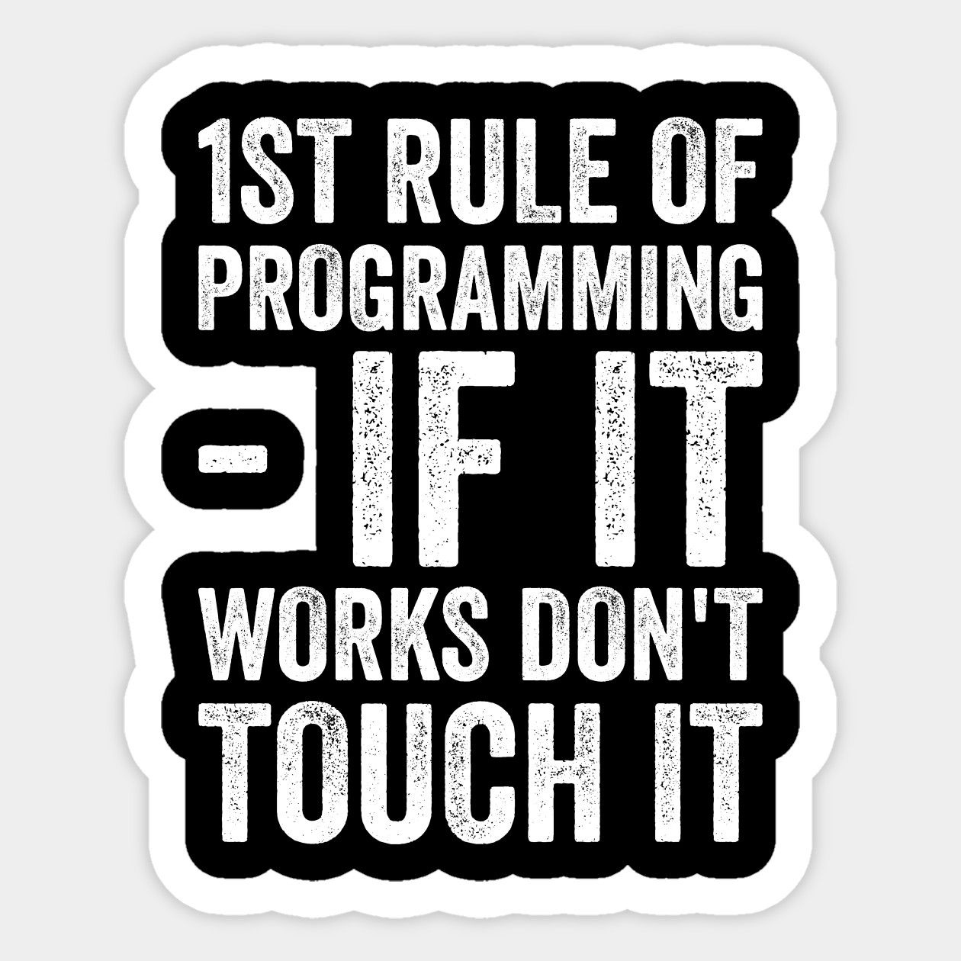
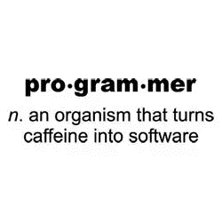
7

Slide 8
Step by step process
User :
Sign UP
Login
Profile Management
Select Course
Enroll Course By Paying Money
Access Course
Teacher:
Sign Up
Log in
Profile Management
Add Courses
Admin:
Login
Profile Management
Add Course
Add Users
Add Teachers
8

Slide 9
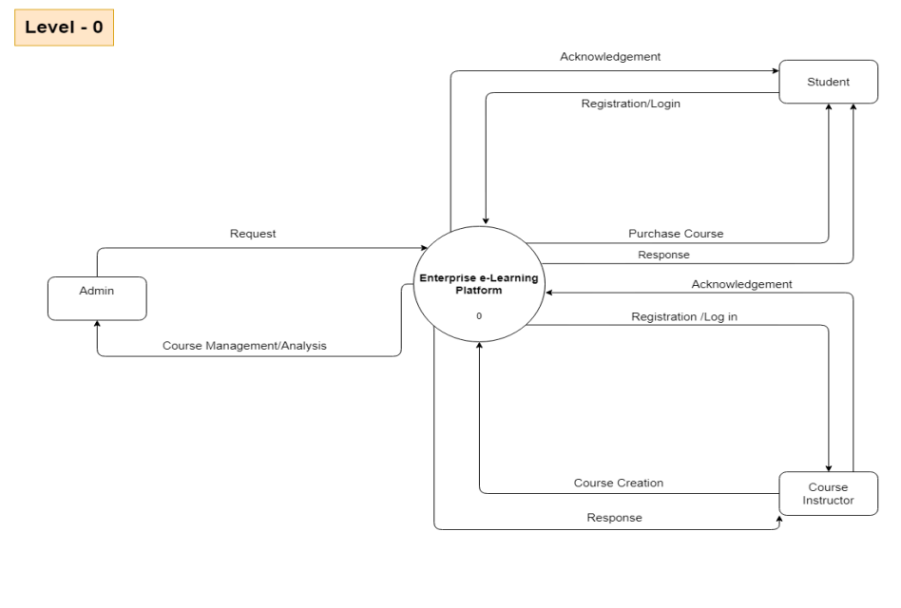
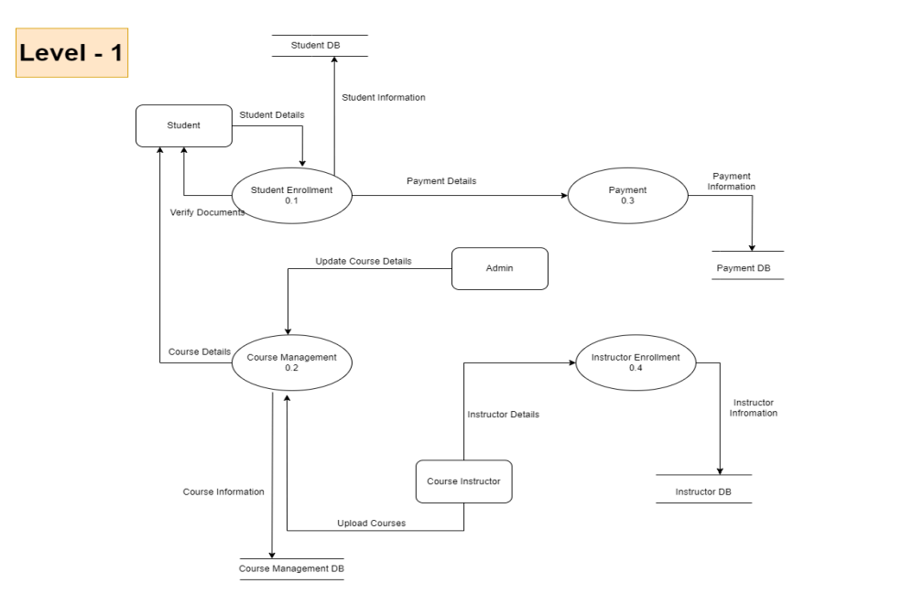
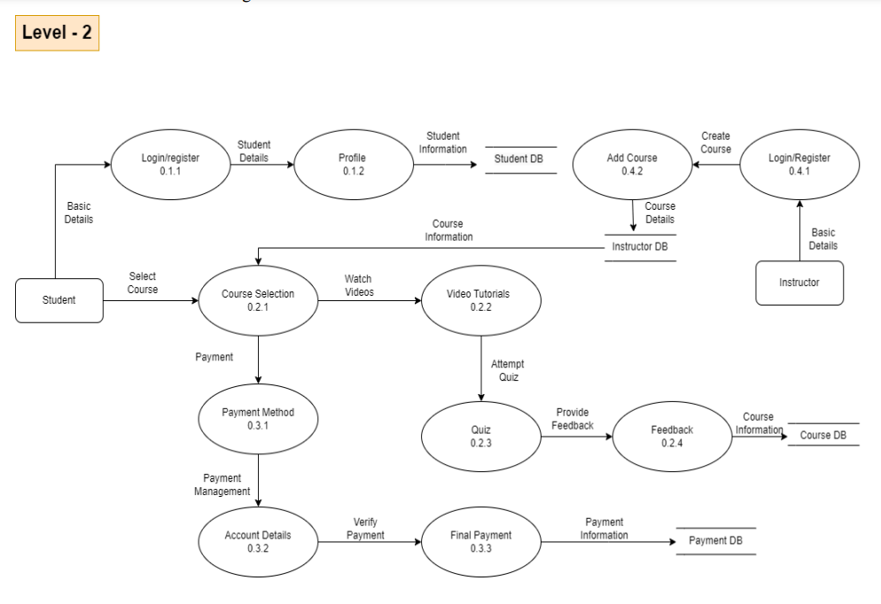
Data flow diagram
9

Slide 10
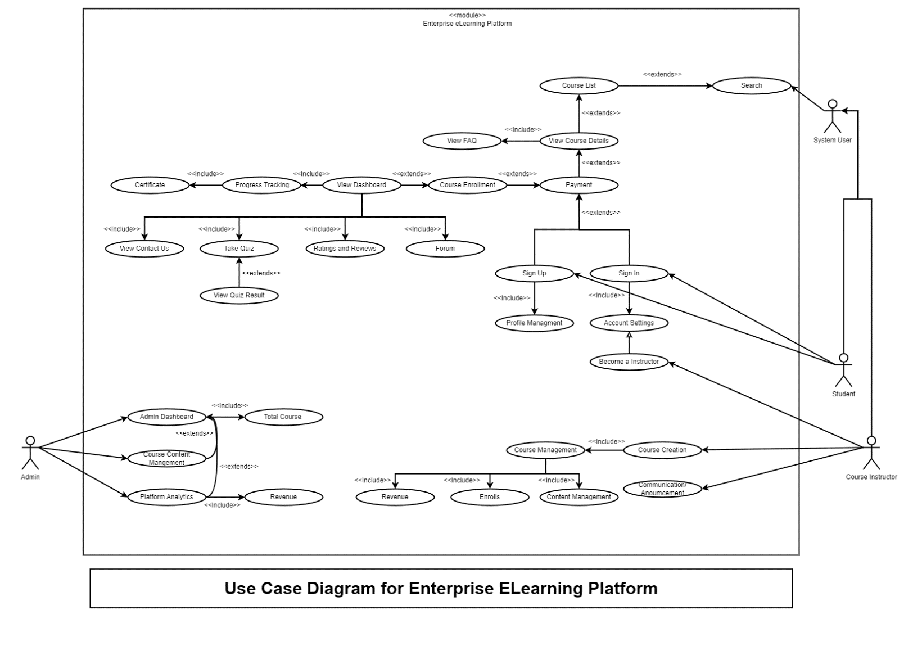
Use Case diagram
10

Slide 11
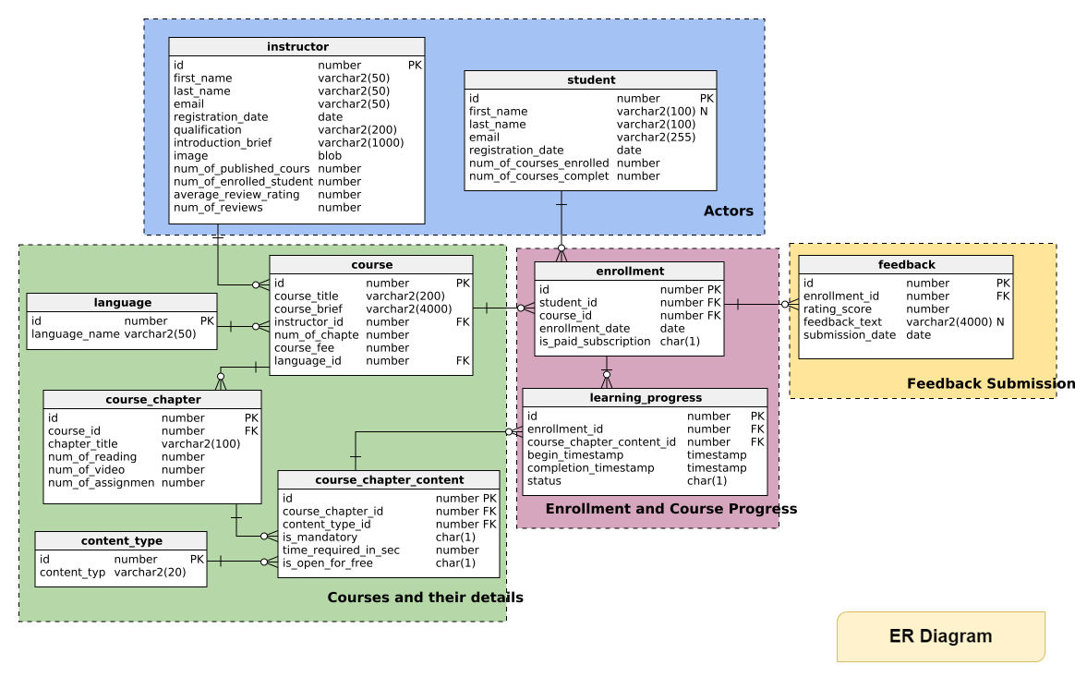
ER Diagram
11

Slide 12
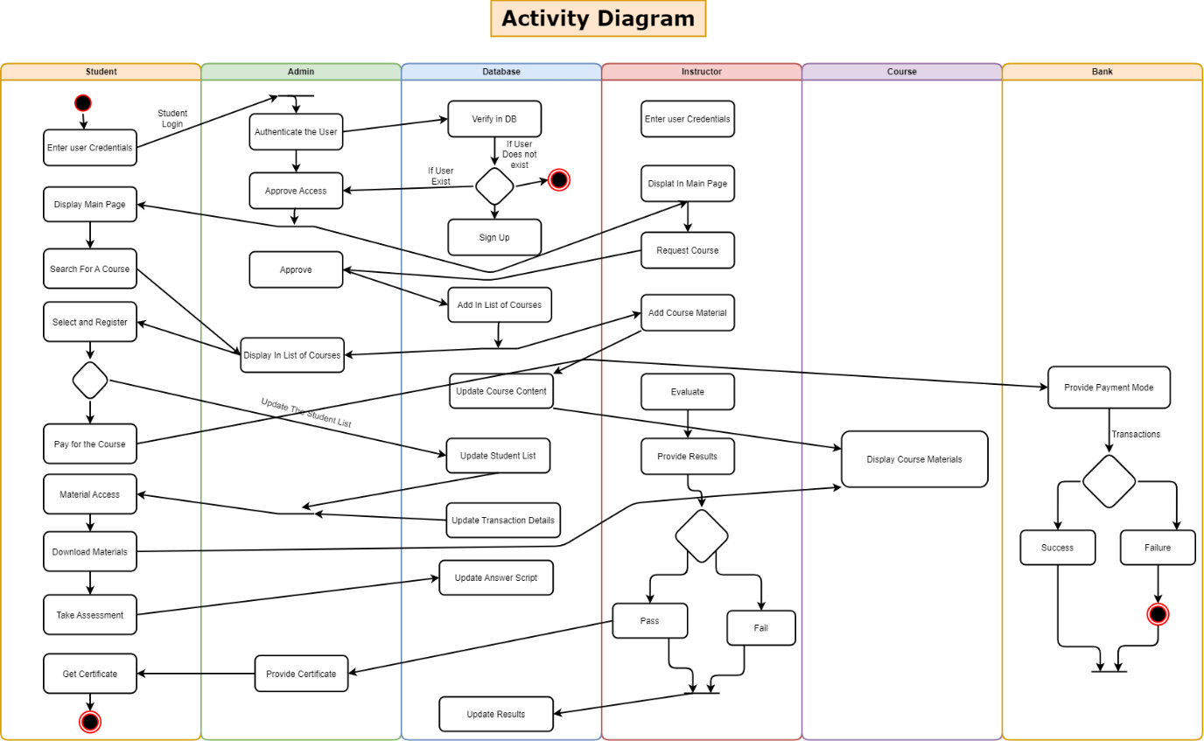
Activity Diagram
12

Slide 13
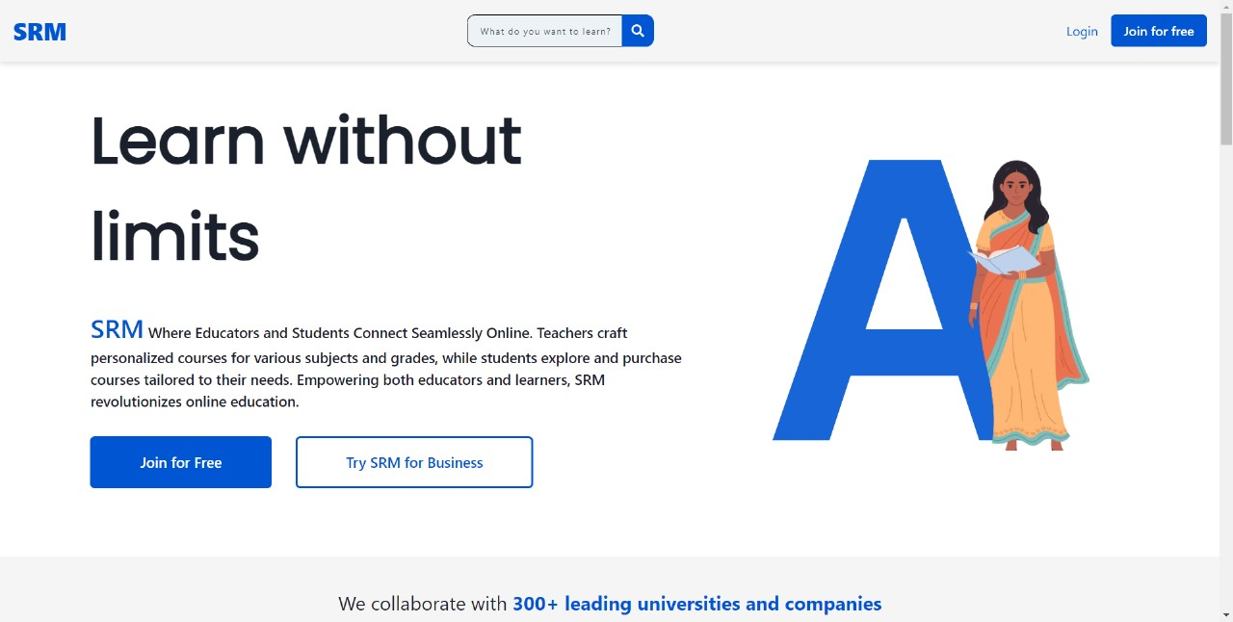
Home page
13

Slide 14
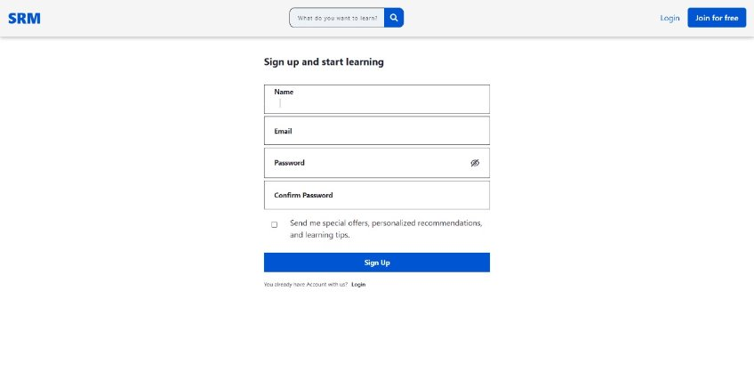
Sign up page
14

Slide 15
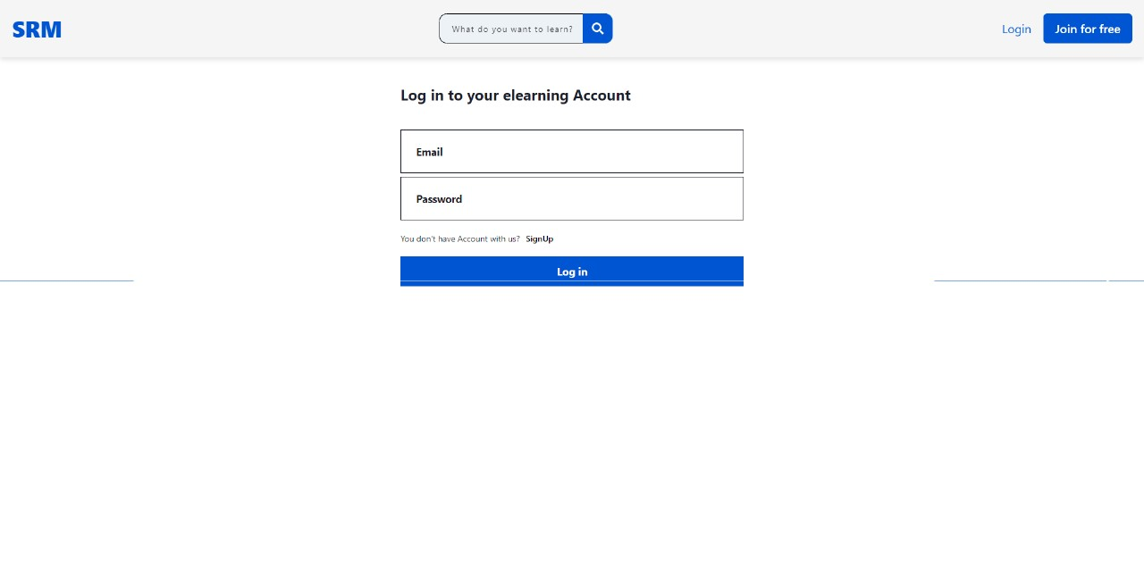
Login page
15

Slide 16
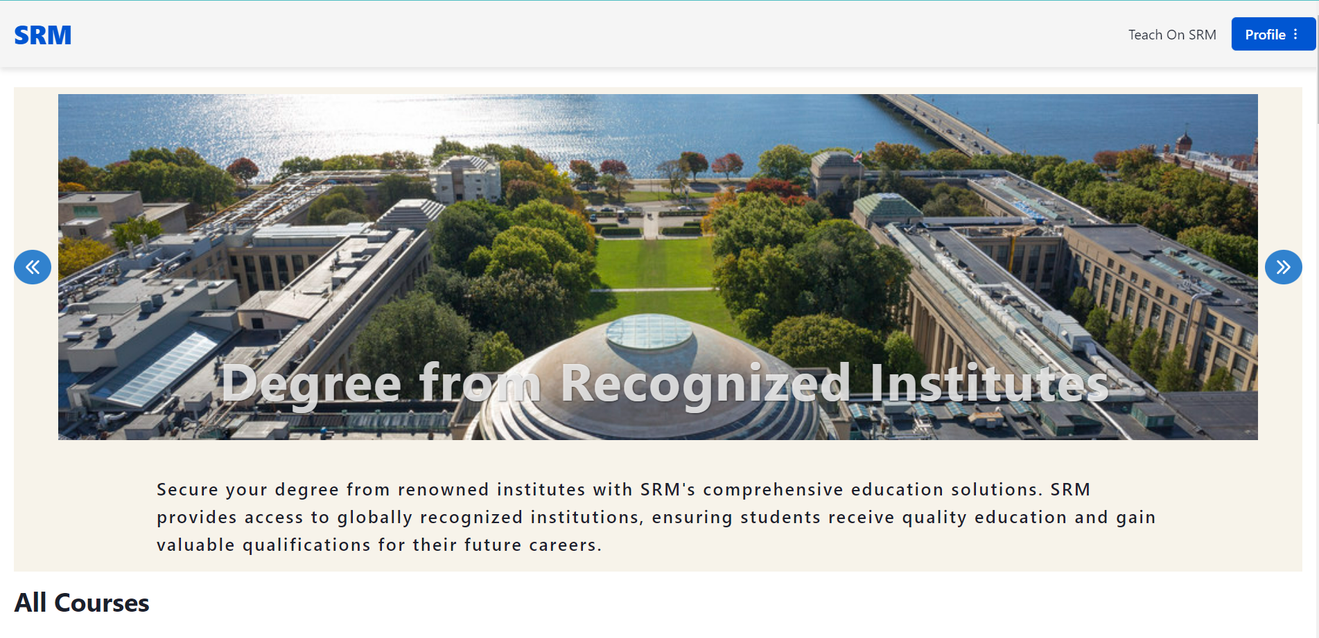
User dashboard
16

Slide 17
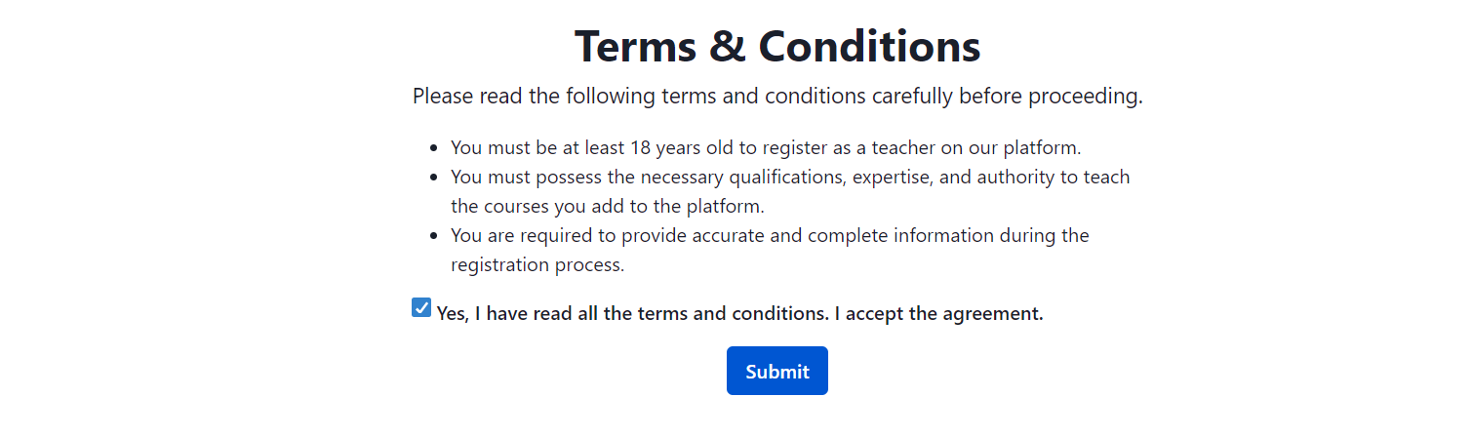
Teacher Verification
17

Slide 18
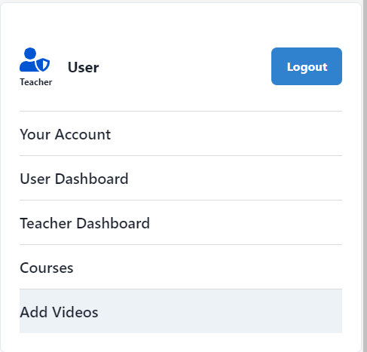
Teacher Operations
18

Slide 19
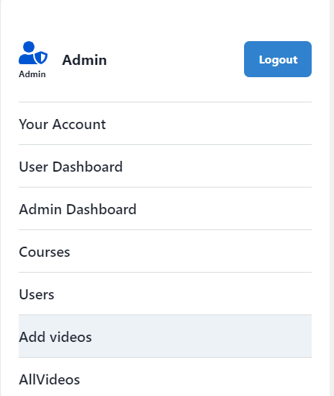
Admin Operations
19

Slide 20
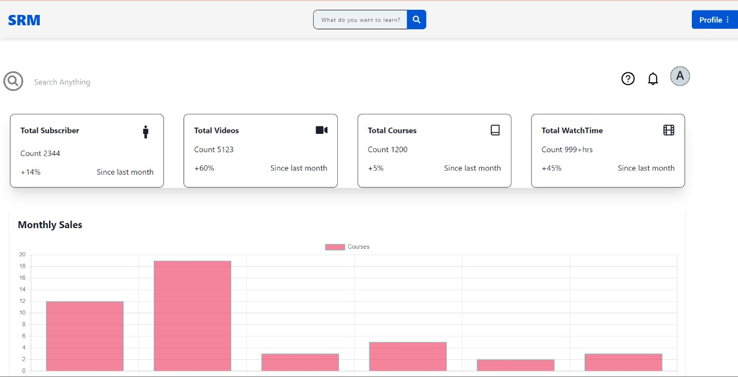
ADMIN dashboard
20

Slide 21
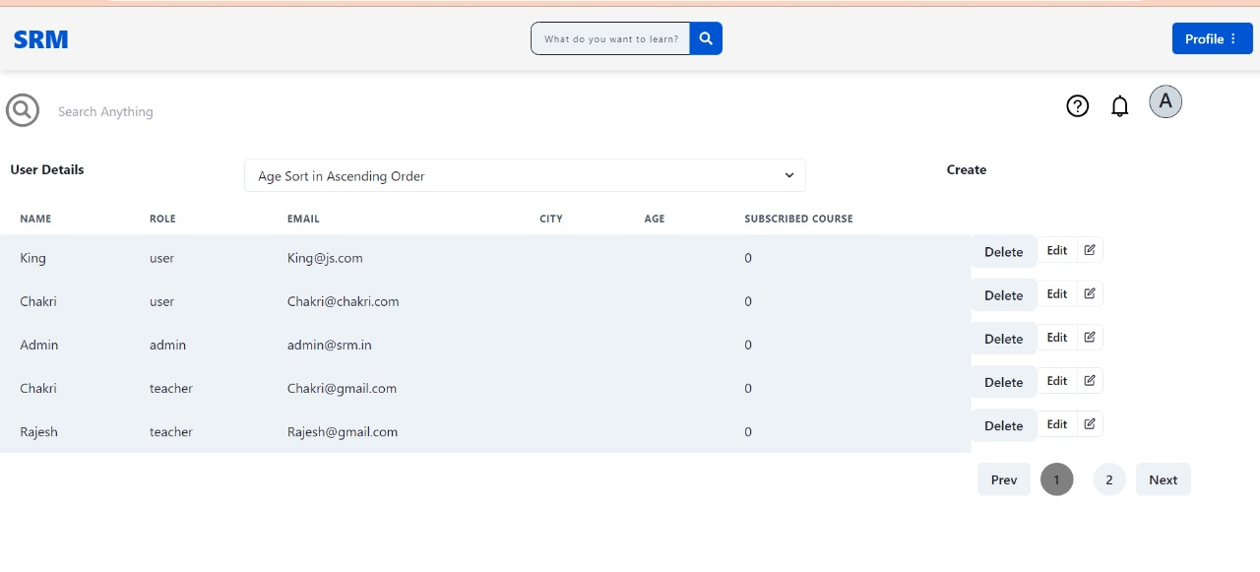
UsERS dETAILS
21

Slide 22
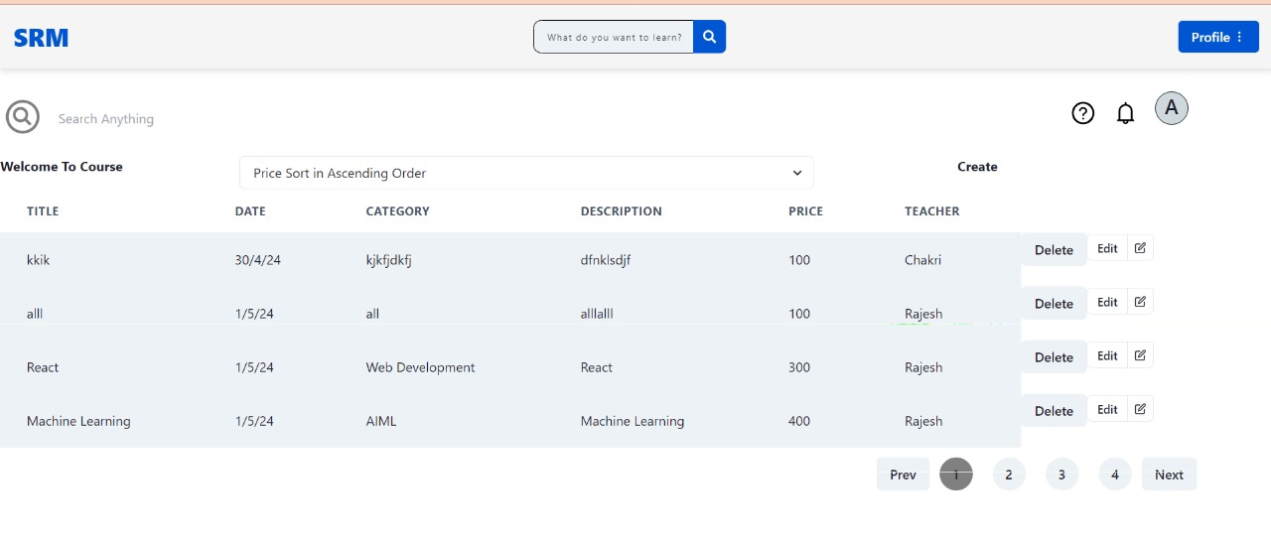
Course dETAILS
22

Slide 23
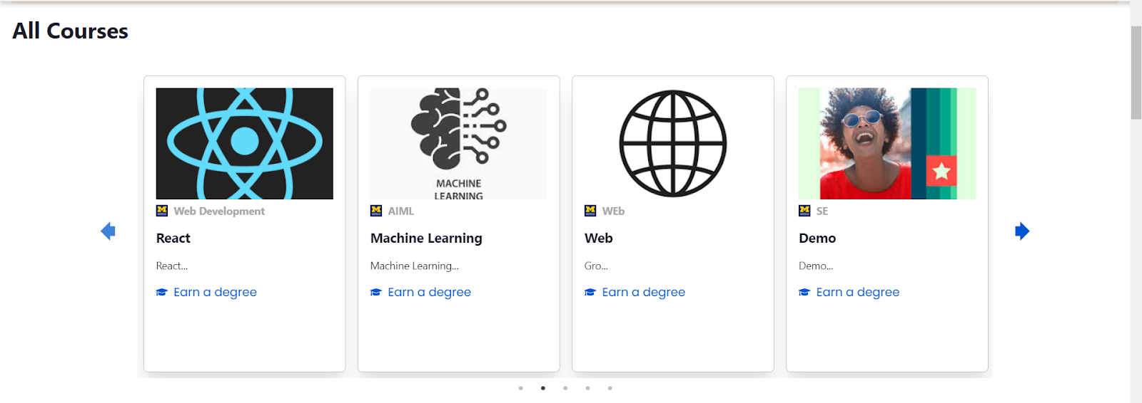
Course dashboard
23

Slide 24
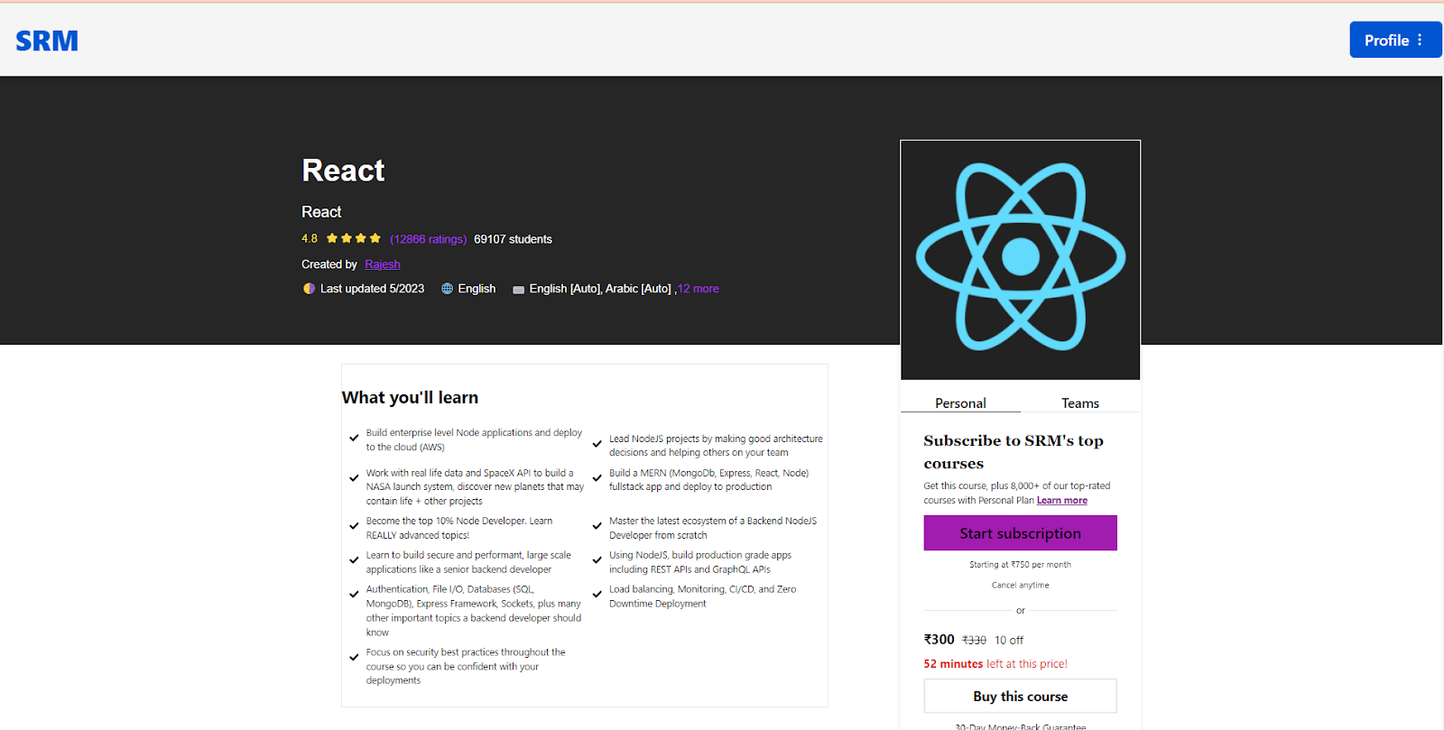
Course overview
24

Slide 25
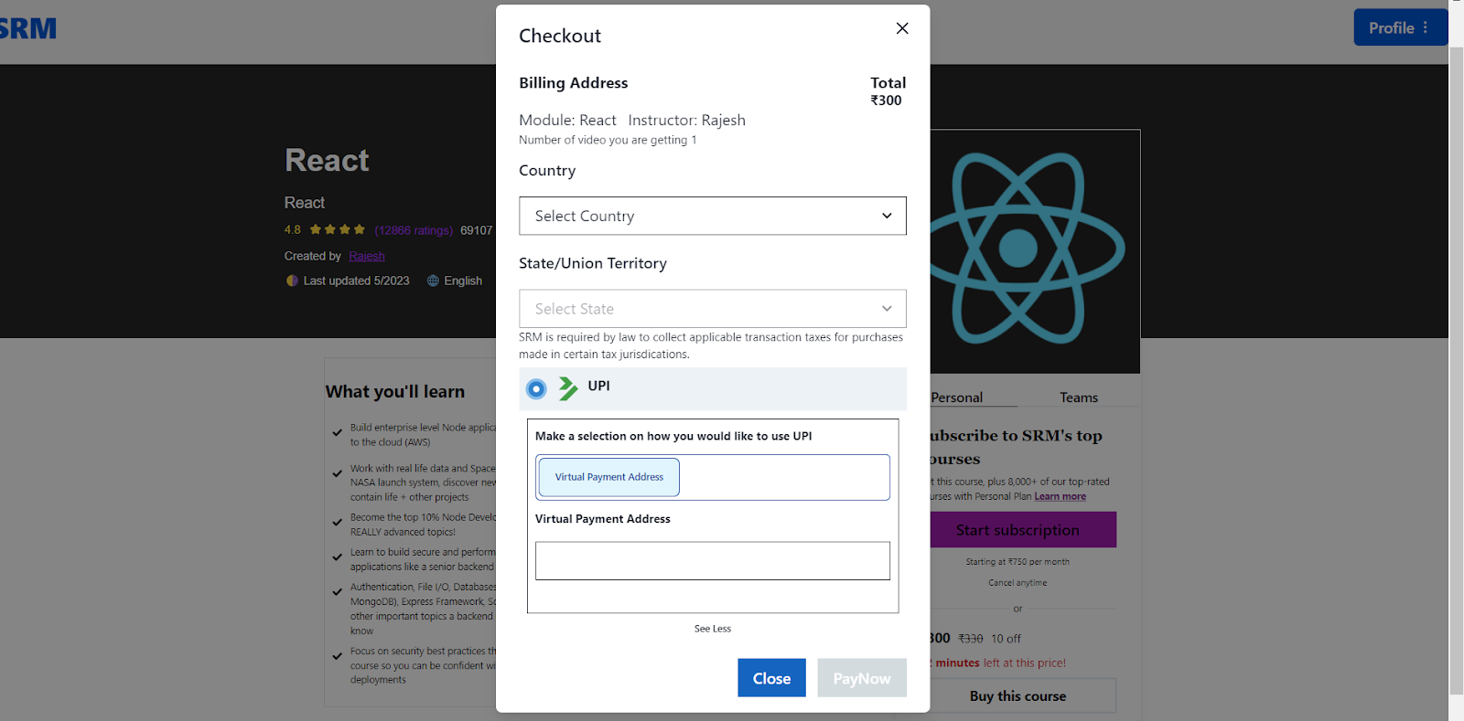
Payment page
25

Slide 26
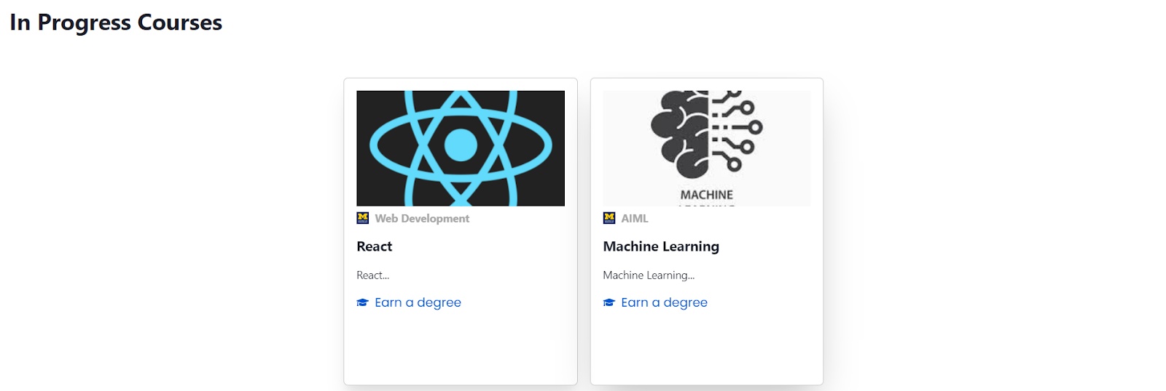
Course dashboard
26

Slide 27
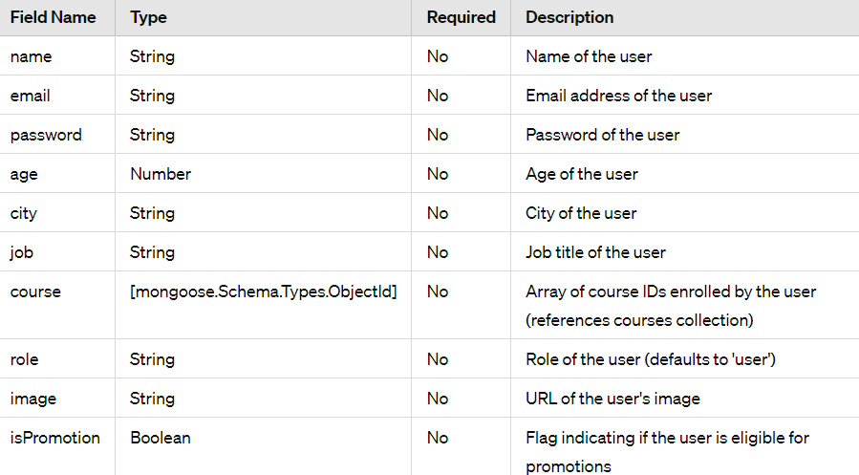
Schema for user module
27

Slide 28
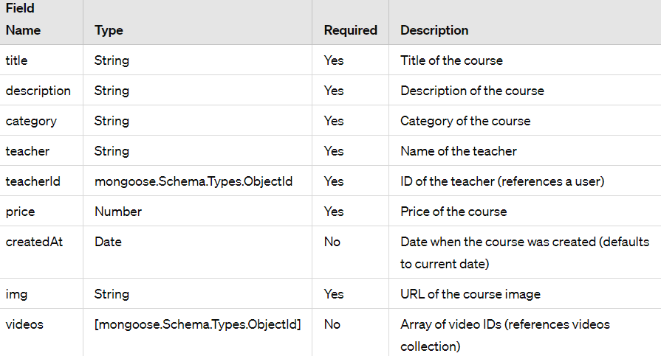
Schema for course module
28

Slide 29
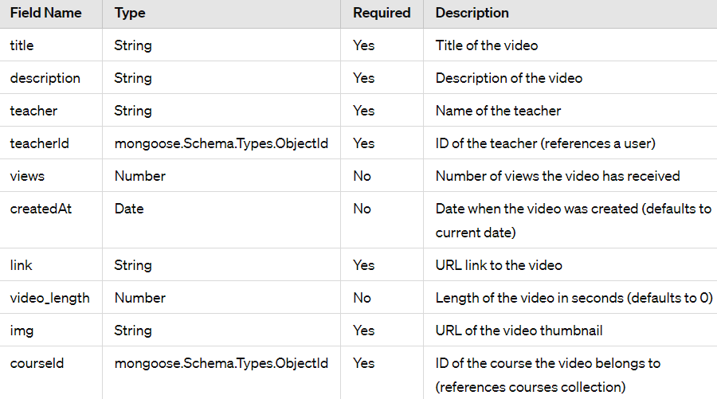
Schema for video module
29

Slide 30
Node modules
Frontend :
Babel
Fetch
React Router
React Dom
chakra-ui/icons
Chakra-ui/react
Tailwind
jwt-decode
Backend :
Mongoose
Bcrypt
Cors
Jsonwebtoken
Express
Nodemon
Multer
Dotenv
Helmet
30

Slide 31
conclusion
In conclusion, the development of the Enterprise E-Learning Platform represents a significant milestone in addressing the challenges students face in accessing quality educational resources tailored to modern industry demands. By leveraging the power of the MERN stack - MongoDB, ExpressJS, ReactJS, and NodeJS - we have created a robust, user-friendly platform that empowers learners worldwide to unlock their full potential.
Our platform's seamless user experience, transparent enrollment process, and comprehensive tracking capabilities set it apart as an innovative solution in online education. The ability for users to conveniently browse, enroll in, and access courses, coupled with the secure payment system and prompt confirmation emails, ensures a smooth and efficient learning journey.
Moreover, the transparent tracking of user engagement provides valuable insights for administrators, enabling them to make data-driven decisions to enhance platform performance and user experience. The platform's architecture and design principles prioritize scalability, security, and usability, ensuring it can adapt to the evolving needs of both learners and organizations.
31

Slide 32
Thank you

